Slide 1
Classes & Inheritance
CS 201, Summer 2013

Slide 2
ADDITIONAL READING
Inheritance
  Chapter 14 of Pearson book
  http://www.cplusplus.com/doc/tutorial/inheritance/
  http://www.learncpp.com/cpp-tutorial/111-introduction-to-inheritance/
Composition
  http://www.learncpp.com/cpp-tutorial/102-composition/

Slide 3
Classes & Inheritance
Think of Classes as a set of functionality and attributes (variables).
Remember that classes can inherit from other classes. We can start with something general, and make a specialized version of it.
Programming & Software Development is about taking real-world problems, and abstracting them to computer code.

Slide 4
A messy program
Display menu option 1 (deposit)
Display menu option 2 (withdraw)
If user enters option 1
  Ask for amount
  If amount > maxDepositAmount
    leftover = maxDepositAmount – amount
    balance += maxDepositAmount
    HeldFunds.add( leftover )
  else
    balance += amount
Else if user enters option 2
  Ask for amount
  ...

Slide 5
An Object-Oriented program
userInterace.DisplayMenu()
choice = userInterface.GetUserChoice()
if choice is DEPOSIT
  amount = userInterface.GetDollarValue()
  bank.HandleDeposit( amount );
else if choice is WITHDRAW
  amount = userInterface.GetDollarValue()
  bank.HandleWithdraw( amount );
userInterface.DisplayBalance( bank.GetBalance() )
We can have multiple objects that have a set of functionality they are responsible for.
The objects can also store variables.
We delegate tasks to classes and their functions.

Slide 6
Other Objects...
EBOOK
Functions:
TurnPageForward( )
TurnPageBackward( )
GoToPage( pageNum)
BookmarkCurrentPage( )
Variables:
currentPage
currentBookTitle
currentChapterTitle
CAR
Functions:
TurnOn( )
SetGear( gear )
PressGasPedal( )
Variables:
currentGear
isOn
distanceTravelled

Slide 7
Other Objects...
WINDOW
Functions:
InitializeWindow( )
ResizeWindow( )
CloseWindow( )
Draw( )
Variables:
x, y coordinates
width, height
backgroundColor
buttonList
BUTTON
Functions:
Setup( x, y, w, h, color, text )
Draw( )
IsClicked( mouseX, mouseY )
Variables:
x, y coordinates
width, height
backgroundColor
text

Slide 8
Other Objects...
UNIVERSITY
Functions:
addClass( name, prereqs, dept )
setClassSchedule( semester )
Variables:
classList
CLASS
Functions:
Setup (name, prereqs, dept )
AddStudent( student )
DropStudent( student )
AddTeacher( teacher )
Variables:
name
prereqList
studentList
department
schedule
teacher
STUDENT
Variables:
name
major
classesTaken

Slide 9
What about similar objects?
WINDOW
Functions:
InitializeWindow( )
ResizeWindow( )
CloseWindow( )
Draw( )
Variables:
x, y coordinates
width, height
backgroundColor
buttonList
BUTTON
Functions:
Setup( x, y, w, h, color, text )
Draw( )
IsClicked( mouseX, mouseY )
Variables:
x, y coordinates
width, height
backgroundColor
text
Duplicate code is bad because you end up having to update multiple places with the same functionality, rather than updating one section of code.
Shouldn't they have a chunk of code in common?

Slide 10
Create a common base class!
WIDGET
Functions:
Draw( )
Variables:
x, y coordinates
width, height
backgroundColor
With a common “Widget” class, we can handle any sort of functionality relating to coordinates, dimensions, color, and drawing to the screen.
Draw() {
SetDrawColor( backgroundColor )
DrawRectangle( x, y, width, height );
}
BUTTON inherits WIDGET
Functions:
Setup( x, y, w, h, color, text )
IsClicked( mouseX, mouseY )
Variables:
text
WINDOW inherits WIDGET
Functions:
InitializeWindow( )
ResizeWindow( )
CloseWindow( )
Variables:
buttonList

Slide 11
Create a common base class!
WIDGET
Functions:
Draw( )
Variables:
x, y coordinates
width, height
backgroundColor
If we decide to change how our widgets draw now, BUTTON and WINDOW will automatically be updated:
Draw() {
// SetDrawColor( backgroundColor )
// DrawRectangle( x, y, width, height );
SetDrawGradient( backgroundColor, WHITE )
DrawRoundedRectangle( x, y, width, height );
}
X
Old Window
New Window
X
Old Button
New Button
* Inappropriate, tacky use of gradients. Will be punished by neared UX designer.

Slide 12


Another example...
PLAYER
Functions:
Move( keyboard )
Draw( screen )
Variables:
velocityX
velocityY
x, y
width, height
image
ENEMY
Functions:
Move()
Draw( screen )
Variables:
velocityX
velocityY
x, y
width, height
image
In a video game, the player and the enemy both have similar functionality –
Both have an image
Both have coordinates & dimensions
Both have a velocity
Both get drawn to the screen
Both move
However, the player movement is dependent on keyboard (or gamepad) input.
The enemy movement is based on AI, where it has to decide where to move next.

Slide 13
Another example...
PLAYER
Functions:
Move( keyboard )
ENTITY
Functions:
Move()
Draw( screen )
Variables:
velocityX
velocityY
x, y
width, height
image
We can create a base entity object that handles all of the generic, shared functionality and variables held by both.
Then when we create a player...
Player bunny;
And call Draw...
bunny.Draw( screen );
The Player class automatically calls its parent (Entity)'s Draw function.
ENEMY
Functions:
Move()

Slide 14
Public, Protected, and Private
A class can classify its members (variables & functions) as...
  Public: The variable or function can be accessed anywhere.
  Protected: The variable or function can only be accessed from within the class itself, and its children.
  Private: The variable or function can only be accessed from within the class itself, and not its children.

Slide 15
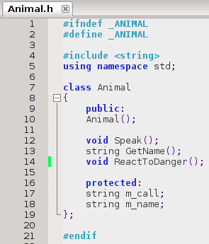
Inheriting...
Here we have a simple Animal class which has a variable m_call, which stores the animal's call.

Slide 16
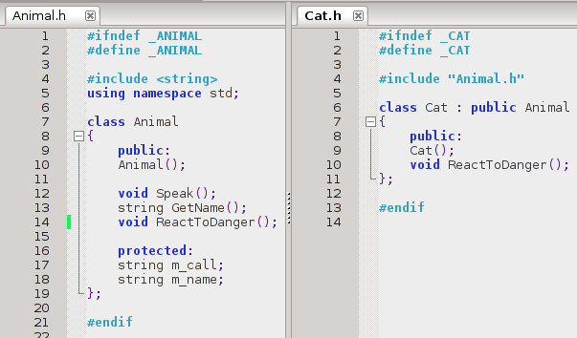
Inheriting...
We then create a class Cat, which inherits from Animal. We add a constructor explicitly, but Speak(), GetName(), and the variables are automatically part of Cat class.
Speak()
GetName()
Automatically use the functionality defined in the Animal class.

Slide 17
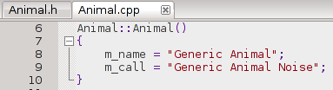
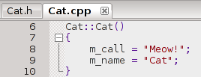
Inheriting...
Within the constructors, we can setup specifics about the class.

Slide 18
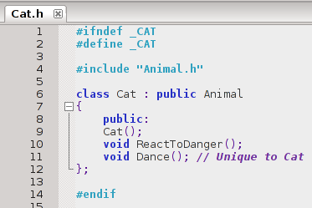
Inheriting...
We could also add additional functionality for Cat that might not be present in generic Animal.

Slide 19
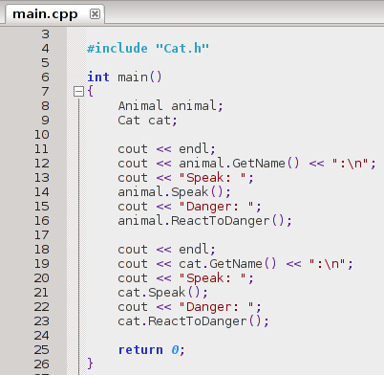
Inheriting...
Now we can use either a generic Animal in our program, or a specific animal implemented in a class inherited from Animal.
We can, in a sense, create an “Animal” interface –
a list of “Functionality” that every Animal can “perform”, and then create specific instances of a given Animal.

Slide 20
More practical uses...
Email attachment class – Create different types of attachments, which are handled differently.
User Interface – Every visual object has (x,y) coordinates, dimensions, and color in common, which can be extended.
Entity – Types of entities in a video game (Player, NPC, enemy, pickup item)
What might have common functionality & attributes, but also might need to be extended further in different directions?

Slide 21
Inheritance: Redefine vs. Overload
When you inherit a class, the parent class' public and protected members are automatically available to the child.
We can also override those functions to change the behavior.
  For example, the Player moves based on keyboard input, but the Enemy moves based on AI.

Slide 22
Inheritance: Redefine vs. Overload
When you Overload a function, the original function is still available – you just have a second option based on unique parameters.
When you Redefine a function, you override its functionality for a specific child class.

Slide 23
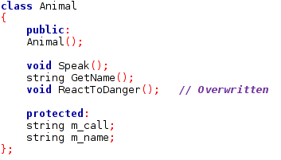
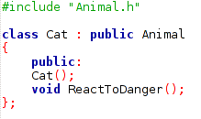


Inheritance: Redefine vs. Overload
To redefine a function, we must redeclare the function within the child class. Then, we can write the function definition (the actual body of the function) with the new behavior.

Slide 24
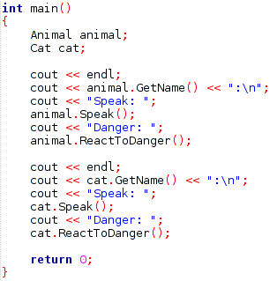
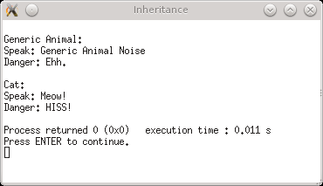
Inheritance: Redefine vs. Overload
Our specialized Cat class now has a different behavior for “ReactToDanger” than the generic Animal.

Slide 25
Inheritance: Constructors & Destructors
Along with member functions, constructors and destructors can also be overridden.
You can call a parent constructor from the child class' constructor.
Destructors aren't explicitly called, and parent constructors are called after the child class.

Slide 26

Initialization List
To call a parent constructor, you can use an Initialization List with the child constructor's definition:
Initialization List
Calling Animal() constructor

Slide 27

Initialization List
For any member variables declared in the class itself (not the parent), you can also use an initialization list to initialize its value.
Member variable declared in Cat class.
m_call and m_name were declared in the Animal class, so you can't initialize them in the child's initializer list.

Slide 28
Inheritance: Multiple Inheritance
In C++, a class can also inherit from more than one parent classes. This might be handy for an object inheriting different types of traits-
  An NPC is both drawable and AI_Controlled, so it might inherit different functionalities from two parent classes.
  An “Image Button” might inherit properties from an Image and a Button class.

Slide 29
Also, Composition...
Composition can be just as important as Inheritance.
Composition is merely giving a class a member variable, which is another class.
ENEMY
Functions:
Update()
Members:
AI_CONTROLLED control
AI_CONTROLLED
Functions:
Move()

Slide 30
Composition
Some argue that it is better to use Composition than Inheritance. You can usually accomplish similar tasks with either.

Slide 31
Composition
Suppose that we have a FileType class, which has functions like SaveFile() and LoadFile().
We want to make different types of files, like a .txt file, .csv file, and .html file.
Our “CSVFile” class could inherit from “FileType”, and therefore inherit the SaveFile() and LoadFile() functions.
Or, “CSVFile” could be a class with no parents, but contain a “FileType” member. (composition)
CSVFile myFile;
myFile.LoadFile( “filename.csv” );
CSVFile myFile;
myFile.fileType.LoadFile( “filename.csv” );

Slide 32
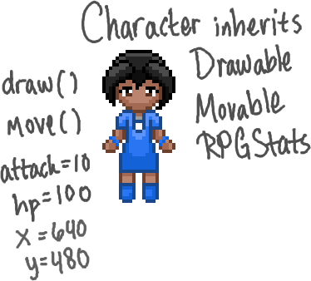
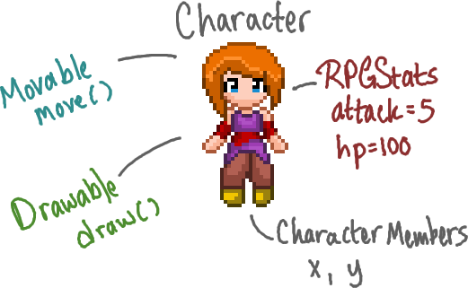
Composition
Composition may be desired because it keeps specific functionality in its own class, rather than “melting” functionality into a child class.
Inheritance: Members become part of the child class with no distinction between
Composition: The class has variables of these data-types, and are cleanly separated into categories.

Slide 33
It's a design decision
It's up to you which is a better choice for the design of your program.

